Slide 1
Risk Management and Threat Modeling
GRC Unit, Day 2

Slide 2

Class Objectives
By the end of today’s class, you will be able to:
Identify threat agents, possible attacks, and exploitable vulnerabilities relevant to a given asset.
Prioritize risks based on likelihood and impact potential.
Choose and justify controls for a given risk.

Slide 3
Risk Management and Threat Modeling

Slide 4

What’s the difference between a vulnerability, a threat, and a risk?

Slide 5

A vulnerability is an aspect of a business that can be exploited to compromise a system’s CIA.
Notes:
11. Instructor Do: lesson plan pg. 32

Slide 6
A threat is an actor that might exploit a vulnerability.
Notes:
11. Instructor Do: lesson plan pg. 32

Slide 7
A risk is the possibility of losing something valuable.
Notes:
11. Instructor Do: lesson plan pg. 32

Slide 8
Risk Management And Threat Modeling
Risk Analysis
Understanding what risks face an organization, which are most severe, and which are most likely.
Risk Management
Using the results of risk analysis to create a plan for preventing likely risks.
Threat Modeling
Determining which attacks an organization is most likely to experience, who is most likely to launch them, and what actions can be done to prevent them.

Slide 9
Remember: What is a business’s primary objective?
Profit!
Risk management and threat modeling directly contribute to business profit.
Risk analysis quantifies how much a business needs to spend in the event of a given security break.
Risks are measured in financial figures, which businesses use to prioritize threats.
Threat modeling results are shared upwards to the executives who make the major business decisions.

Slide 10

Threat Modeling Methodology: PASTA
PASTA: Process for Attack Simulation & Threat Analysis
PASTA focuses on aligning considerations of business objectives with technical requirements.
Notes:
Image Source: Ryan Huettl

Slide 11

Threat Modeling Methodology: STRIDE
STRIDE: Spoofing, Tampering, Repudiation, Information Disclosure, DoS (Denial of Service), Elevation of Privilege
STRIDE focuses on identifying what can fail in the system being modeled.
Notes:
Image Source: Kishan Vagale

Slide 12

Threat Modeling Methodology: OWASP
Today, we’ll focus on OWASP
OWASP: Open Web Application Security Project
OWASP focuses on identifying possible threats, prioritizing risks, and planning mitigation strategies. It is mainly used with web and desktop applications.
Notes:
Image Source: Spencer Powell

Slide 13
OWASP
The OWASP Threat Modeling process consists of six steps.
1
2
3
4
5
6
Determine assessment scope
Identify threat agents
Identify potential attacks
Identify exploitable vulnerabilities
Prioritize identified risks
Mitigate risks

Slide 14
Step 1 Determine Scope
List the assets under consideration, determine their value, and define objectives for your threat modeling assessment.
Businesses can’t effectively evaluate everything at once, so they adjust their scope to focus on a specific category of risk.
Example: Performing a risk analysis to assess the weakness of a network infrastructure. Within this scope, we are not concerned with application security.
Scoping begins with asset inventory, the process of identifying and assigning asset value to all of an organization’s assets.
Example: The asset value of a web application could be measured by the revenue or profit it generates.

Slide 15
Step 2
Identify Threat Agents
Determine which attackers would be interested in the relevant assets.
Threat agents include a person or group that can produce a threat, whether or not that person or group is malicious.
Threat agents include:
APTs (Advanced Persistent Threats)
Script kiddies
Employees opening phishing emails
Incompetent user breaking configurations on company computer
Today, we’ll focus on malicious threat agents.
Previously in class, we addressed unwitting threat agents, like employees opening phishing emails.

Slide 16
Step 3
Identify Potential Attacks
Identify the attacks each agent is likely to perform.
Different attackers use different modes of attacks. Different attacks mean different risks and different considerations.
Example: Script kiddies will have different goals than a disgruntled employee.
We can identify a potential attack by considering the threat agent’s:
Motivation
Skill level
Amount of funding
Example: If a client’s web application is taken offline by a DoS attack, the severity of the risk depends on which threat agent is responsible.
Script kiddies might DoS a server simply to cause trouble.
An APT might DoS a server as a smoke screen to steal valuable data.

Slide 17
Step 4 Identify Exploitable Vulnerabilities
Identify the most vulnerable points in a system, how the agent will deliver the attack, and where an attack is most likely to occur.
Once we determine who might attack and what methods they might use, we determine where exactly in the system they will likely direct their attacks, and what will be at risk if they do.
Example: If a network has only one database that stores everything, the entire company will lose access to all data if it is compromised. An attacker seeking to DoS the company's network can exploit this database to achieve their goal.

Slide 18
Activity: Threat Modeling: Steps 1-4
In this activity, you’ll learn more about GeldCorp’s business operations and assets before applying steps 1-4 of the OWASP process.
Instructions shared on Slack.
30 Minutes

Slide 19
Threat Modeling: Steps 1-4

Slide 20
Risk Analysis

Slide 21

Risk Analysis
Risk analysis is the process of prioritizing threats identified in steps 1-4 based on their potential impact and likelihood.
Scenario
You’ve identified more than 10 potential attacks that GeldCorp should consider. All can be mitigated, but each fix costs around $2.5k. GeldCorp’s Security Department only has $10k budgeted for the project. You must provide guidance on which four fixes should be prioritized.
Before completing this activity, we’ll learn about:
Qualitative vs. Quantitative Risk Analysis
Likelihood, Impact, and Loss Expectancies
Risk Factor and Heat Maps
Notes:
Image source: shutterstock_1007349100

Slide 22

Qualitative Analysis
Quantitative Analysis
Evaluating risk based on intangible, unmeasurable factors.
Used when analysis leads to decisions without the need of cost-benefit analysis.
Evaluating each risk based on its measured likelihood and impact.
Likelihood: The probability an event will take place.
Impact: The measure of damage done if a risk takes place.
Notes:
Image Source: AdobeStock_202154008

Slide 23

Qualitative Risk Analysis
In some situations, likelihood and impact cannot be accurately measured.
QUALITATIVE
Example 1: It’s impossible to calculate the precise probability that some lone attacker, somewhere in the world, will attack your servers within the next year.
Example 2: It’s impossible to determine the precise impact of a breach. The cost of an attack will depend on its length, which is impossible to determine ahead of time.

Slide 24


Qualitative Risk Analysis
Used when a complex evaluation of cost vs. benefit is unnecessary.
Example: When a company is deciding between an inexpensive VPN service that logs traffic on its servers for internal use, and a more expensive service that does not keep any logs.
A bakery can use qualitative analysis to decide on an inexpensive VPN, since it shouldn’t matter much if they’re logging non-confidential information.
A government defense or financial organization can use qualitative analysis to decide on a more expensive service, since it knows it needs to keep its data confidential.
Notes:
Image sources: shutterstock_683984128 (bakery); shutterstock_1259409754 (bank)

Slide 25
Quantitative Risk Analysis: Example 1
However, there are circumstances where intuitive analysis is insufficient.
QUANTITATIVE
Example: The Security Department wants to invest in protecting the organization's infrastructure.
In order to secure the money from the Finance Department, they must justify their ask. They present a quantitative risk analysis to demonstrate that the cost of not investing is much greater than the budget they're requesting.

Slide 26
Quantitative Risk Analysis: Example 2
However, there are circumstances where intuitive analysis is insufficient.
QUANTITATIVE
Example: The Executive Team must decide whether to migrate to a new cloud provider as part of negotiations with a potential partner.
This transition has major financial implications. To make the decision, they need an accurate assessment of potential losses due to downtime, retraining, risk of data corruption during migration, and other issues.

Slide 27

Asset Value and Exposure Factor
To perform quantitative risk analysis, analysts start by calculating how much it will cost if an asset is breached.
They first quantify asset value and exposure factor.
As discussed earlier, asset value is how much money an asset is worth in currency.
The exposure factor is how much of an asset will be affected in the event of a breach.
In other words, will an attack result in partial / temporary or complete / permanent destruction of an asset.

Slide 28
Determining Exposure Factor
Exposure factor is always somewhat subjective. We apply a numerical value depending on the level of damage an exploited risk would produce.
1.0
Attack would completely eliminate an asset.
.75
Attack would mostly eliminate an asset.
0.5
Attack would half eliminate an asset.
.25
Attack would partially eliminate an asset.

Slide 29
Loss Expectancy
The measure of how much money an organization will lose in the event of a given breach.
Single Loss Expectancy (SLE) Estimated cost of the risk occurring on a given asset.
SLE = AVE x EF
AV = Asset Value
EF = Exposure Factor
Annual Rate of Occurrence (ARO) Estimated number of times the risk is likely to occur in a given year.
ARO = SLE x 12
Annual Loss Expectancy (ALE) Estimated cost of a risk reoccurring in a given year.
ALE = SLE x ARO

Slide 30
Loss Expectancy
Categories of loss expectancy refer to the degree of a breach’s impact.
Marginal
Notable
Severe
Catastrophic
The organization has the resources to respond to the breach immediately, without affecting day-to-day operations or revenue.
The organization has the resources to respond to the breach, but may not be able to do so immediately. May experience interruptions to operations.
The organization experiences serious interruptions to operations, and doesn’t have the monetary and/or personnel resources to respond to effectively. May have to defer revenue, delay project timelines, reassign employees, and/or hire consultants to address the issue.
The organization suffers severe, lasting damage to its reputation and/or infrastructure. The future of the business is threatened by reputational damage, bankruptcy, being found in contempt of federal regulations, or other issues.

Slide 31
In the next demonstration, we’ll see data presented in spreadsheet and visual formats through risk matrices and heat maps.

Slide 32
The Risk Spreadsheet

Slide 33

Notes:
Image source: AdobeStock_56885471

Slide 34
Activity: Threat Modeling Step 5 - Risk Analysis
In this activity, you will complete a spreadsheet and generate a risk matrix and heat map for GeldCorp.
(Instructions sent via Slack.)
30 Minutes

Slide 35
Threat Modeling: Step 5 - Risk Analysis

Slide 36
Mitigating Risks

Slide 37
Now that we’re able to determine which threats are worth our attention and resources, we can craft controls for mitigating risks.

Slide 38
Deciding on Security Controls
Answer the following questions when determining an appropriate control.
Should the control be physical, administrative, or technical? (Required Control Type)
How strong does the control really need to be? (Required Strength of Control)
How much does the control cost compared to the benefit provided?
(Cost of Implementation)
How long will the control take to implement? (Time of Implementation)

Slide 39

Risk Mitigation: Example
LifeNotes is a new medical records company that makes it easy for doctors from different hospitals to share medical records.
When transferring a patient to another hospital or physician, they can use the application to share the patient’s medical history, lab results, and medication schedules.
LifeNotes also ensures that doctors can only see records for their own patients.
However, a client recently reported that they were able to load records for patients they were not assigned to.
This violates regulatory standards protecting patient medical information, and must be resolved immediately.
Notes:
Image source: shutterstock_110078714

Slide 40

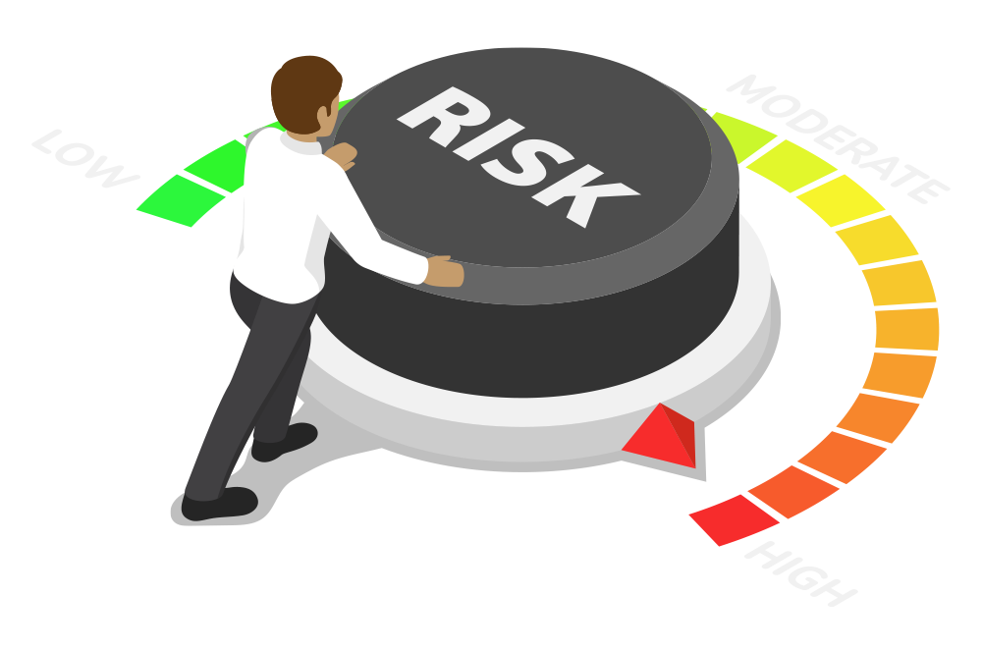
Risk Mitigation: Example
What security controls should we suggest to LifeNotes?
Required Control Type?
Required Control Strength?
Control Decisions?
Cost of Implementation?
Time of Implementation?

Slide 41
Activity: Threat Modeling Step 6 - Risk Mitigation
In this activity, you will conceptualize a risk mitigation plan.
Instructions shared on Slack.
15 Minutes

Slide 42
Threat Modeling Step 6 - Risk Mitigation

Slide 43
Class Objectives
By the end of today’s class, you will be able to:
Identify threat agents, possible attacks, and exploitable vulnerabilities relevant to a given asset.
Prioritize risks based on likelihood and impact potential.
Choose and justify controls for a given risk.

